Slide 1
Data Centre Infrastructure
CT109-3-2 and Version 2
Introduction and Overview

Slide 2
Lecturer information
Lecturer Name: Dr Arun
Email:
kchandran.arun@staffemail.apu.edu.my
Telephone:017-6506265

Slide 3
Pre-requisites for this module
None

Slide 4
Aims of this module
The purpose of Data Centre Infrastructure is to provide knowledge of the various elements within a data center, the various specialisms involved, and the associated best practices.
Data center infrastructure/design requires a multi-disciplinary solution, therefore this module is not intended to give students the ability to individually manage, control or optimize all aspects of a data center design or build but to provide them with the skills to work with assistance from experts in other disciplines to deliver an overall design and efficiency strategy

Slide 5
Learning outcomes
At the end of this module, YOU should be able to:
Analyse the options for Data Centre designs including the requirements, Tier standards, design strategies and network architecture for building an effective Data Center (C4,PLO2) - Final Exam
Justify the suitable IT hardware and space requirements for a data centre design (A3,PLO9) – Assignment [Individual Component]
Propose data centre design plan with electrical, mechanical and other supporting systems (A5,PLO4) - Assignment [Group Component]

Slide 6
Student Learning Time (SLT)
Module Credit Value:3
Total Learning Hours:
Lecture: 2 hours per week
Tutorial: 1.5 hours per week

Slide 7
Topics we will cover – CLO1-Final Exam
Introduction to Data Centre
Data Centre Purpose & Requirements
Data Centre Design Strategies
Colocation
Network Architecture Design
Data Centre Tiers

Slide 8
Topics we will cover - Group Assignment –CLO2&CLO3
IT Hardware
IT Space
Cooling System
Electrical Distribution System
Building and Energy Management Systems
Fire Suppression System

Slide 9
What is expected of you
What is expected of you
You should abide to all the rules & regulation of APU
Proper attire
No speaking of dialects
Attendance is compulsory and valid medical certificates or letters from parents /guardians must support any absence from class.
Three lateness will be equal to one absence
All pagers and handphones should be turned off during lectures.

Slide 10
What support is available for you
Consultation hours
Resources
Reference material
Internet resources

Slide 11
How you will be assessed
COURSEWORK weighted at 50%.
An EXAM length 2 HOURS weighted at 50%.

Slide 12
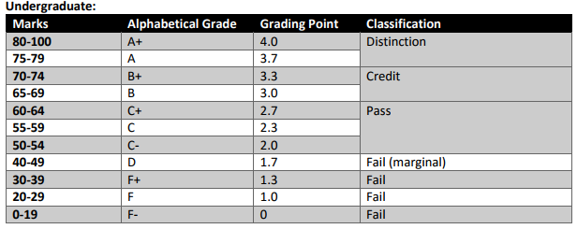
Achievement requirements

Slide 13
Question and answer session
Q & A

Slide 14
What we will cover next
Introduction to the data center

